Slide 1
Hackathon’25 : Solve Rubik’s Cube

Slide 2
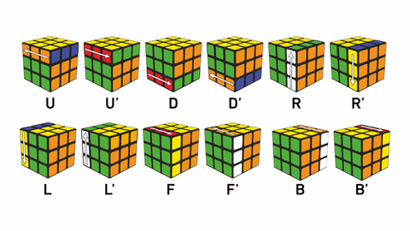
Solve Rubik’s Cube
Overview
Participants are challenged to design and implement an algorithm that can solve a standard 3x3 Rubik’s Cube from any scrambled state. The solution must mimic the real-world logic of solving a cube through a sequence of valid moves.
What We’re Looking For : 🔍
Problem-Solving Approach
How do you break down the problem?
How do you model the cube’s state and transitions?
Use of Data Structures
How do you represent the cube internally (e.g., arrays, trees, graphs)?
Use of efficient structures to track states and operations.
State Prediction Logic
Ability to track and predict cube state after each move.
Design of a move engine to simulate rotations and track permutations.
Algorithm Efficiency
How fast can your solution reach the solved state?
Complexity (time and space) of your algorithm.
Bonus Evaluation Areas
Creativity in solution design.
Visual simulation or cube UI (optional but Wow factor).
Scalability for different cube sizes (2x2, 4x4, etc.) : Optional
Deliverables:
Working algorithm (code)
Brief walkthrough/presentation of your approach
Output example(s) from your solver
It’s Not Just a Puzzle - It’s a Test of Mind, Math, and Moves!

Slide 3
CubeMinds: A Visual-Intelligent Rubik’s Cube Solver “It’s not just a puzzle — it’s a test of Mind, Math, and Moves!”
This project simulates a Rubik’s Cube solving process using real-world move logic, intelligent prediction, and animated output — all with a modular Python core and a 3D HTML visual.

Slide 4
Problem-Solving Approach
We approached the problem by modeling the cube as a collection of six 3×3 face grids (U, D, F, B, L, R). Each move (like U, U') is treated as a transformation involving:
Rotation of a face (90° clockwise or counter-clockwise)
Edge transfers between adjacent sides
Logging and animation of moves
The problem is broken down into:
Cube Representation using dict[str, List[List[str]]]
Move Engine with reversible transformations
State Tracker to simulate and log each action

Slide 5
Data Structures Used
Dictionary (dict) – To represent the 6 faces of the cube.
2D Lists – Each face is a 3x3 grid representing stickers.
MoveTracker Class – Logs each move and simulates animation.
Random Generator – For scrambling using valid moves.
Why it's special: Every move is animated with a 0.3s delay, mimicking real-world cube solving rhythm and enhancing clarity.

Slide 6
State Prediction Logic
To predict the cube’s state:
Each move manipulates rows/columns of multiple faces.
rotate_face(face, clockwise=True) performs 90° rotations.
The scrambled and solved states are visualized using a flattened cube printer.
Example: If U is applied:
The top layer of Front, Right, Back, and Left rotates accordingly.
The U face matrix is rotated clockwise.

Slide 7
Algorithm Efficiency
Each face rotation is O(1)
Scrambling is O(n), where n = number of steps
Solver placeholder supports integration with:
Beginner’s Method
CFOP (Cross, F2L, OLL, PLL)
IDA* or BFS search trees
Built with extensibility in mind — currently supports U and U', can be extended to all 18 legal moves.
Bonus: A mock voice-based input determines the number of scramble steps

Slide 8
Special Features
What makes CubeMinds unique:
Voice-Simulated Scramble Input
MoveTracker Animation (0.3s step delay)
Flattened Human-Friendly Cube Printer
3D Rubik's Cube Visualizer (cube_visual.html) using Three.js
Designed for 2x2, 3x3, 4x4 scalability
Beginner-Friendly Output Logs + Modular Architecture
It’s not just code — it’s an experience, built from scratch.

Slide 9
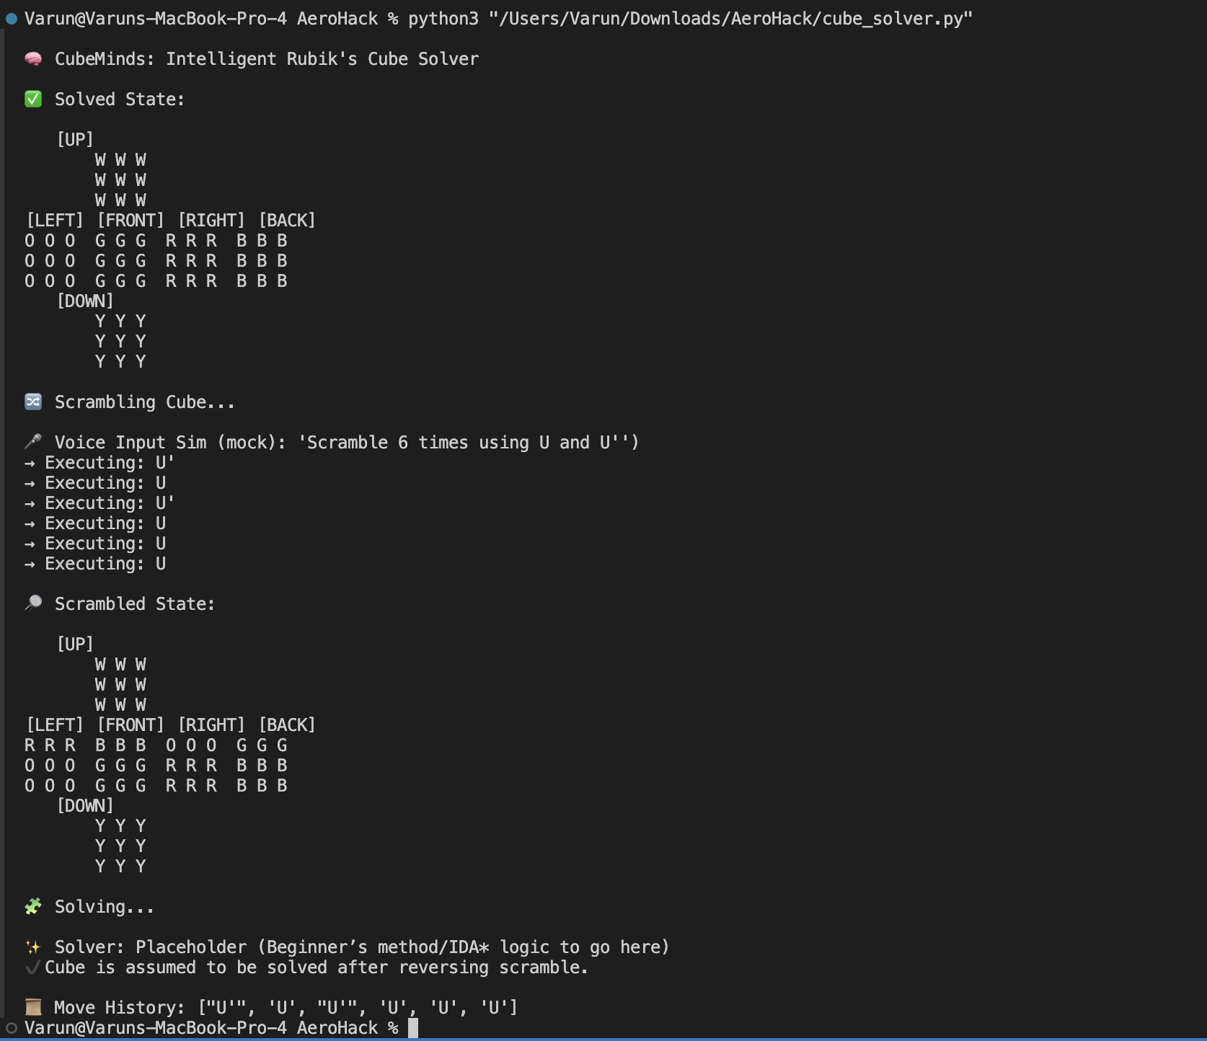
Output Example

Slide 10
Folder Structure
Varun_Raj.zip
├── AeroHack_CubeMinds.pptx ← This PPT
├── cube_solver.py ← Python algorithm
├── cube_visual.html ← 3D Web visual
├── README.txt ← How to run + details

